Slide 1
Teaching Pack – Straight line graphs
Lesson 2: Drawing linear graphs from equations
Cambridge IGCSE™
Mathematics 0580
Version 1.0

Slide 2
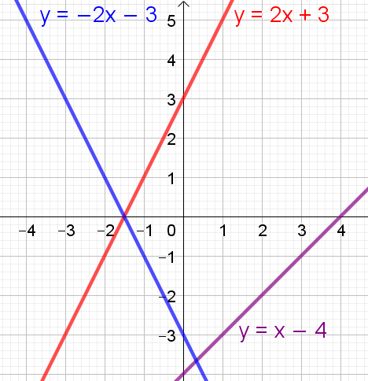
Draw graphs for these equations
y = −2x − 3
y
y = 2x + 3
y = x − 4
y = x − 4
y = 2x + 3
x
y = − 2x − 3
y = x − 4

Slide 3
Find the gradient of each line
y = −2x − 3
y
y = 2x + 3
y = x − 4
y = x − 4
gradient = 1
y = 2x + 3
gradient = 2
x
y = − 2x − 3
gradient = −2
y = x − 4

Slide 4
Find the y-intercept of each line
y = −2x − 3
y
y = 2x + 3
y = x − 4
gradient = 1
y-intercept = (0, −4)
y = 2x + 3
gradient = 2
x
y-intercept = (0, 3)
y = − 2x − 3
gradient = −2
y = x − 4
y-intercept = (0, −3)

Slide 5
You are now going to investigate further…
y = −2x − 3
y
y = 2x + 3
y = x − 4
y = x − 4
y = 2x + 3
x
y = − 2x − 3
y = x − 4

