Slide 1
Teaching Pack – AO2 Application
Understanding business activity
Cambridge IGCSETM
Business 0450
Version 1

Slide 2
AO2 Application
In the exam, you are often provided with some information about the business the question is focussed on. For example, you might be told the type of business, its future plans, how many employees there are etc.
To ensure you are applying your business knowledge, you will need to focus your answer on the specific business mentioned in the question.
This means your answer will be in ‘context’.
You will need to use the information given, when answering questions to help demonstrate that you are applying you knowledge.

Slide 3
AO2 Application: an example
Work with the person next to you to create a list of all the different ways a company might motivate its workers.
Notes:
Examples might include:
Job rotation
Training
Team working
Flexible working
Pay rise
Bonus
Increase Commission rate
Career development
Promotional opportunities
Fringe benefits – company car, staff discounts, free meals
More responsibility
Praise and recognition
Improved working conditions
Variety of tasks

Slide 4
AO2 Application: an example
Now look at your list and decide which methods would be best for each of the companies below:
Business A manufactures cars
Business B sells kitchen equipment to hotels

Slide 5
AO2 Application: an example
Method of motivation | Business A Manufactures cars | Business B Sells kitchen equipment to hotels
Praise and recognition
Increase commission
More responsibility
Company car
Opportunities for promotion
Job rotation
Notes:
Discuss with learners each method of motivation and they ‘tick’ if it is suitable for Business A, Business B or both if appropriate. As you discuss answers ask learners to give reasons for them. – answers are below to help facilitate discussion.
ANSWERS
Praise and recognition - BOTH
Increase commission - B
More responsibility - BOTH
Company Car - B
Promotional opportunities - BOTH
Job Rotation - A

Slide 6
AO2 Application: example summary
Application is about using the information about the business when answering questions and not just stating the name of a business.
You need to think about the business’s activities (what their business is and does) and putting that business context into your answer.
You have done this in the activity you have just completed:
you considered the type of business
you selected appropriate methods of motivating workers for that type of business
you applied that knowledge correctly to each type of business and its activities.

Slide 7
Task 1
On Worksheet A there are four statements about businesses.
You need to read each one and then decide if they are applied in context with the business or not.
You will have to explain your answer.

Slide 8
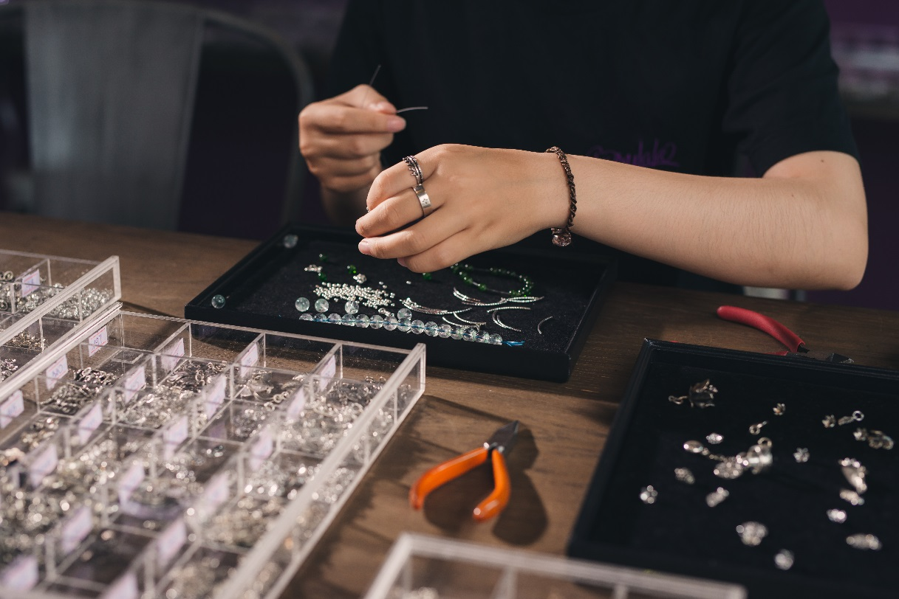
Task 2: Building an answer
You will need to use Worksheet B to help build your answer to the question below. We will work through it step by step.
Paula owns a small jewellery making business. She sells her jewellery online and at craft fairs. She specialises in making silver jewellery.
Paula works out her prices based on the cost of the raw material (silver) and then adds a mark up, which also includes her labour time.
Question:
Explain the impact on Paula’s business if the price of silver was to rise.

Slide 9
Task 2: Step 1 – identify what the question is asking
Question:
Explain the impact on Paula’s business if the price of silver was to rise.
The question is about the price of silver going up and the effect this might have on a small business.

Slide 10
Task 2: Step 2 – the context of the business
Question:
Explain the impact on Paula’s business if the price of silver was to rise.
Think back to earlier in the lesson when we discussed context and what it means. Paula is a silver smith (someone who makes silver objects / items). This means she relies on silver to make her jewellery. If the price of silver goes up then her costs will rise as it will cost her more for her raw material (silver). If her costs rise because of this, she may need to put up the price of her jewellery, or keep the price the same if her competitors do this, and therefore accept lower profit margins.

Slide 11
Task 2: Step 3 – the content of your answer
Question:
Explain the impact on Paula’s business if the price of silver was to rise.
What you need to do in your answer is show that you understand the effect a price rise of a raw material has on a small business. You will also need to put your answer in the context of Paula’s business, i.e. a silver jewellery maker and not just any business. Remember, you will gain marks for developing these links to show the effect of the rise in the price of silver on Paula’s business as this is what you have been asked to explain.

Slide 12
Task 2: Step 4 – writing your answer
Question:
Explain the impact on Paula’s business if the price of silver was to rise.
Now use the notes you have made on Worksheet B to write your own answer to this question.

Slide 13
Plenary
Be prepared to share your answer with the class.
You will receive feedback on your answer which you should use to make corrections and improve your work.
In our next lesson you will be developing your skills of application further.

Slide 14
Task 2: Step 4 – your answer might look like this
Question:
Explain the impact on Paula’s business if the price of silver was to rise.
If the price of silver rises, each item of jewellery Paula makes will cost her more to make. She may choose pass on the increase in cost to customers by increasing her prices. However, if she does this she is at risk of losing sales if her competitors don’t increase their prices. If she chooses not to pass the rise in cost on to the customer, she will need to absorb the cost herself, and either find other ways to cut costs or accept a lower profit margin.’

